Slide 1
Electrical and Computer Engineering Capstone Project Proposal 2/21/2015 Erebus Labs Open Sensor Platform
Submitted By:
Colten Nye
Steve Peirce
Golriz Sedaghat
Supervisor:
Dr. Lisa Zurk
Sponsors:
Dr. Mike Borowczak
Dr. Andrea Burrows

Slide 2
Introduction

Slide 3
Project Statement

Slide 4
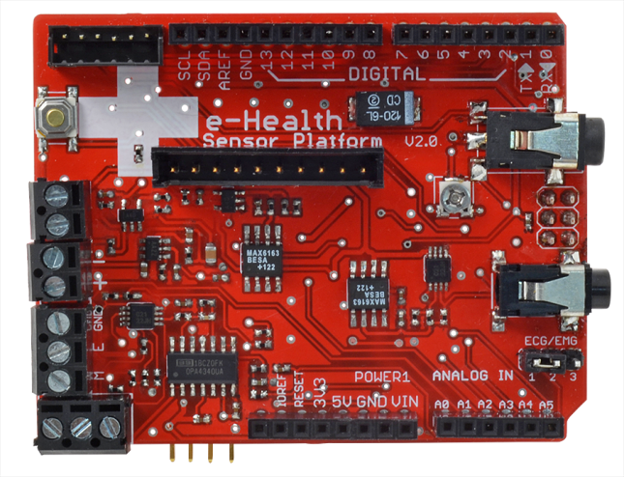
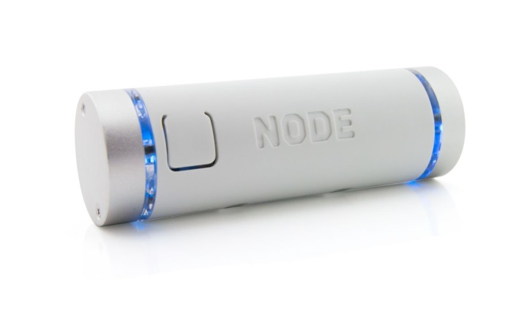
Comparable Devices
The e-Health Sensor Shield allows Arduino and Raspberry Pi users to perform biometric and medical applications by using 10 different sensors. Biometric information gathered can be wirelessly sent using Wi-Fi, 3G, GPRS, Bluetooth, 802.15.4 and ZigBee depending on the application. The complete kit is available for € 450 ($512 approximately).
The NODE Sensor Platform allows students to explore concepts in science. Data can be collected using Vernier’s Graphical Analysis on iOS or Android devices. The NODE Sensor Platform includes accelerometer, gyroscope, and magnetometer. Two expansion ports allow students to connect additional sensor modules. The platform is available for $149.

Slide 5
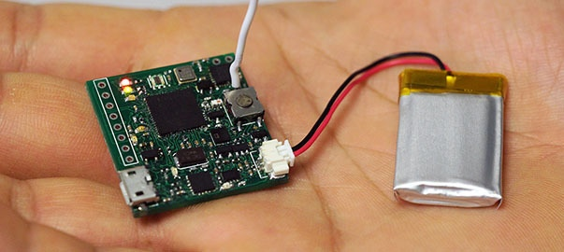
Comparable Devices (Contd.)
ArduIMU V4, An Arduino Based Integrated Measurement Unit, is a fully open source complete wireless sensor module. That gives access to SPI, I²C, UART, analog input and PWM output, which would allow developers to design and develop their custom shields. ArduIMU V4 is available for $129.95.

Slide 6
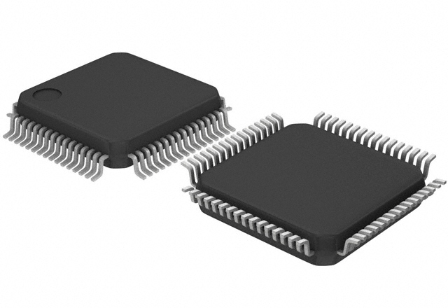
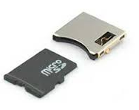

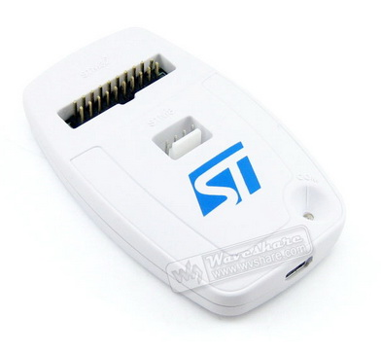
Methodology

Slide 7
Schedule
Project Schedule

Slide 8
Budget
Part # | Part Name | Manufacturer | Vendor | Qty | Unit Cost | Cost
STM32F205RCT6 | MCU | STMicroelectronics | Mouser | 5 | $9.01 | $45.05
SDBMF-00915B0T2 | SD Connector | MULTICOMP | Newark | 5 | $3.07 | $15.35
LM2936MP-3.3/NOPB | Voltage Regulator | Texas Instrument | Mouser | 5 | $1.78 | $8.90
ZX62R-B-5P | Micro USB, Type B, Male | Hirose Connector | Mouser | 5 | $1.27 | $6.35
PCB | N/A | OSH Park | N/A | 5 | $15 | $80
Total |  |  |  |  | $30.13 | $155.65

Slide 9
Reference
http://www.vernier.com/products/sensors/wireless-sensors/node/
https://www.kickstarter.com/projects/494937902/arduimu-v4-an-arduino-based-integrated-measurement
http://www.cooking-hacks.com/documentation/tutorials/ehealth-biometric-sensor-platform-arduino-raspberry-pi-medical

